Slide 1

Gokaraju Rangaraju Institute of Engineering and Technology (Autonomous) Department of CSE(AI&ML)
PROJECT WORK PHASE-1 (GR22A4082) Academic Year 2025-2026
AI Guardian for Content Creators using BERT
Under the Guidance of:
Mr. N. Devendhar
Assistant Professor
AIML
Presented by: Batch AB04
1. R Ravi Kumar (22241A66B5)
2. P Harshavardhan Reddy(22241A66B1)
3. B Pavan Sai (22241A6673)

Slide 2

1. Introduction
Artificial Intelligence & Social Communities
Artificial Intelligence (AI) refers to computer systems capable of performing tasks that normally require human intelligence such as perception, reasoning, and decision-making.
Social creator communities are digital spaces where individuals share content, collaborate, and engage with audiences.
These communities face challenges like misinformation, plagiarism, online harassment, and unverified content spread.
AI can act as a guardian, monitoring, assisting, and protecting creators while ensuring a safer and more productive environment.

Slide 3
1. Introduction (contd…)
Benefits of AI in Creator Communities Content
Protection: Detects plagiarism, copyright violations, and content theft.
Improved Safety: Monitors and filters harmful or abusive interactions.
Enhanced Productivity: Provides AI-driven assistance for editing, summarizing, and content optimization.
Trust & Credibility: Ensures authenticity of shared information.
Community Growth: Encourages positive engagement and collaboration.
Applications of AI-Powered Guardian
Content Verification: Checks originality and sources of shared content.
Automated Moderation: Detects hate speech, spam, or harmful comments.
Skill Assistance: Daily AI-based learning support for creators (summarization, idea generation, etc.).
Well-being Monitoring: Encourages healthy digital habits and reduces burnout.
Reputation Management: Identifies and prevents reputation-damaging trends.

Slide 4
2. Problem Statement
Online content creators struggle with toxic, hateful, and spam comments, while existing moderation tools are too generic and fail to handle community-specific culture, slang, and context.
Ineffective moderation leads to high false positives and negatives, forcing creators into mentally exhausting manual review, which causes burnout, lowers engagement, and reduces community trust.
An intelligent, adaptable AI-driven system is required to learn from each creator’s unique audience, accurately detect harmful content, automate moderation, and preserve genuine community expression.

Slide 5
3. Abstract
The AI-Powered Guardian for Creator Communities is an intelligent moderation system aimed at improving the online environment for content creators and their audiences. By employing a custom-trained deep learning model, the system automatically detects and manages toxic, hateful, and spam comments on platforms like YouTube. Unlike generic moderation tools, its novelty lies in its ability to be fine-tuned on a creator's specific comment data, allowing it to understand community-specific nuances and slang, leading to higher accuracy and fewer false positives. This system helps prevent creator burnout by automating a mentally draining task and fosters healthier, more inclusive online communities, ensuring the long-term sustainability and economic viability of a creator's channel.

Slide 6
4. Objectives of the Project
To develop an intelligent moderation system for a YouTuber's channel.
To automatically detect and manage toxic, hateful, and spam comments using a custom-trained deep learning model.
To understand the specific slang and context of a creator’s community.
To provide a highly accurate filter that protects both the creator and their audience from harmful content.

Slide 7
5. Literature Survey (Existing Approaches)
Reference Number | Title | Methodology | Results/Remarks
[1] | Secure Comment Safeguarding Online Discussions with Intelligent Toxic Comment Filtering (IATMSI 2024, IEEE) | Built an ML pipeline combining text preprocessing, TF-IDF features, and supervised classifiers for toxic comment detection. | Achieved strong filtering precision. Aligns as it focuses on automating toxic comment removal, the same core objective of our system.
[2] | Toxic Comment Analyzer using BERT (ICI 2023) | Fine-tuned BERT on large-scale toxic datasets; used contextual embeddings for toxic vs. non-toxic classification. | Outperformed ML baselines. Aligns because we’ll also fine-tune on YouTube data for accuracy.

Slide 8
5. Literature Survey (Existing Approaches) contd…
Reference Number | Title | Methodology | Results/Remarks
[3] | Toxic Comment Classification Using S-BERT and Random Forest (IC3 2022) | Toxic Comment Classification Using S-BERT and Random Forest (IC3 2022) | Toxic Comment Classification Using S-BERT and Random Forest (IC3 2022)
[4] | Multilingual Abusive Comment Detection at Scale (NeurIPS D&B 2022) | Multilingual Abusive Comment Detection at Scale (NeurIPS D&B 2022) | Multilingual Abusive Comment Detection at Scale (NeurIPS D&B 2022)

Slide 9
5. Literature Survey (Existing Approaches) contd…
Reference Number | Title | Methodology | Results/Remarks
[5] | HASOC 2023 Subtracks (FIRE 2023) | Shared task with hate/offense detection across Indic languages using CNNs, transformers, and ensembles. | Best F1 ≈ 0.65. Aligns because our project also needs classification into abusive/review/neutral in real-world contexts.
[6] | Overview of HASOC 2023 (ACM FIRE Proceedings) | Benchmarked abusive language systems in low-resource languages; surveyed methods. | Provided datasets and baselines. Aligns since benchmarking helps validate our own model’s performance.

Slide 10
6. Software & Hardware Requirements
Software Requirements
S.No | Requirement Type | Technology/ Software
1 | Programming language | Python
2 | Frameworks | TensorFlow, PyTorch, NLTK, SpaCy, Hugging Face Transformers
3 | API | YouTube Data API v3, Google Sheets API
4 | Database & Storage | MySQL, Cloud Storage (Google Cloud)
5 | Development Tools | Django / FastAPI, Docker, Git & GitHub
6 | IDE / Editor | VS Code, PyCharm

Slide 11
6. Software & Hardware Requirements (contd…)
Hardware Requirements
S.No | Computing Resources | Purpose
1 | Processor (Intel i5 / AMD Ryzen 7) | To handle model training, API requests, and backend services efficiently
2 | RAM (16 GB minimum) and OS (windows) | To support deep learning frameworks, multitasking, and large datasets
3 | GPU (NVIDIA RTX 3060 / Tesla T4 or higher) | For accelerating deep learning model training and inference
4 | Storage (512 GB SSD) | For storing datasets, model checkpoints, and system files
5 | Network (High-speed Internet ≥ 50 Mbps) | To access YouTube API, Google Sheets API, and cloud resources

Slide 12
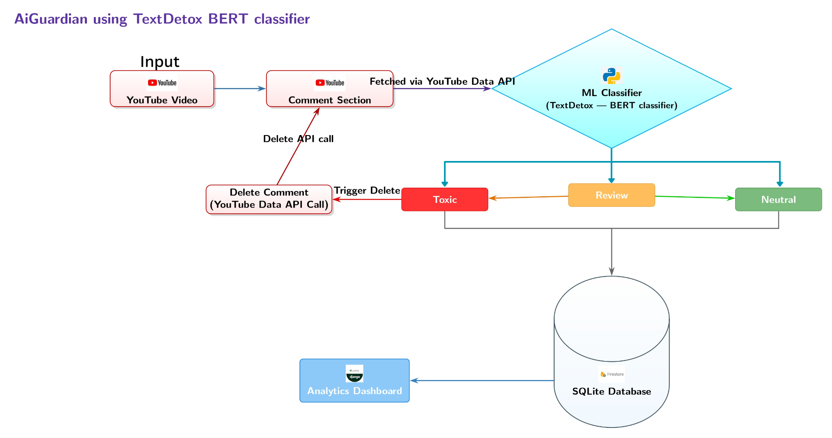
7. Proposed Method: Architectural Diagram
Fig 1. The architecture of AI-Powered Guardian for Creator Communities

Slide 13
System Architecture Overview
This architecture outlines an automated YouTube comment moderation system.
Fetch: Python scripts use the YouTube API to pull comments from a video.
Classify: A machine learning model automatically analyzes each comment, sorting it as Toxic, Neutral, or flagging it for Review.
Store & Visualize: All comments and their statuses are saved in an SQLite database, which powers a user interface featuring a dashboard and analytics.
Improve: A feedback loop allows moderators' corrections to be used for model retraining, continuously improving the classifier's accuracy.

Slide 14
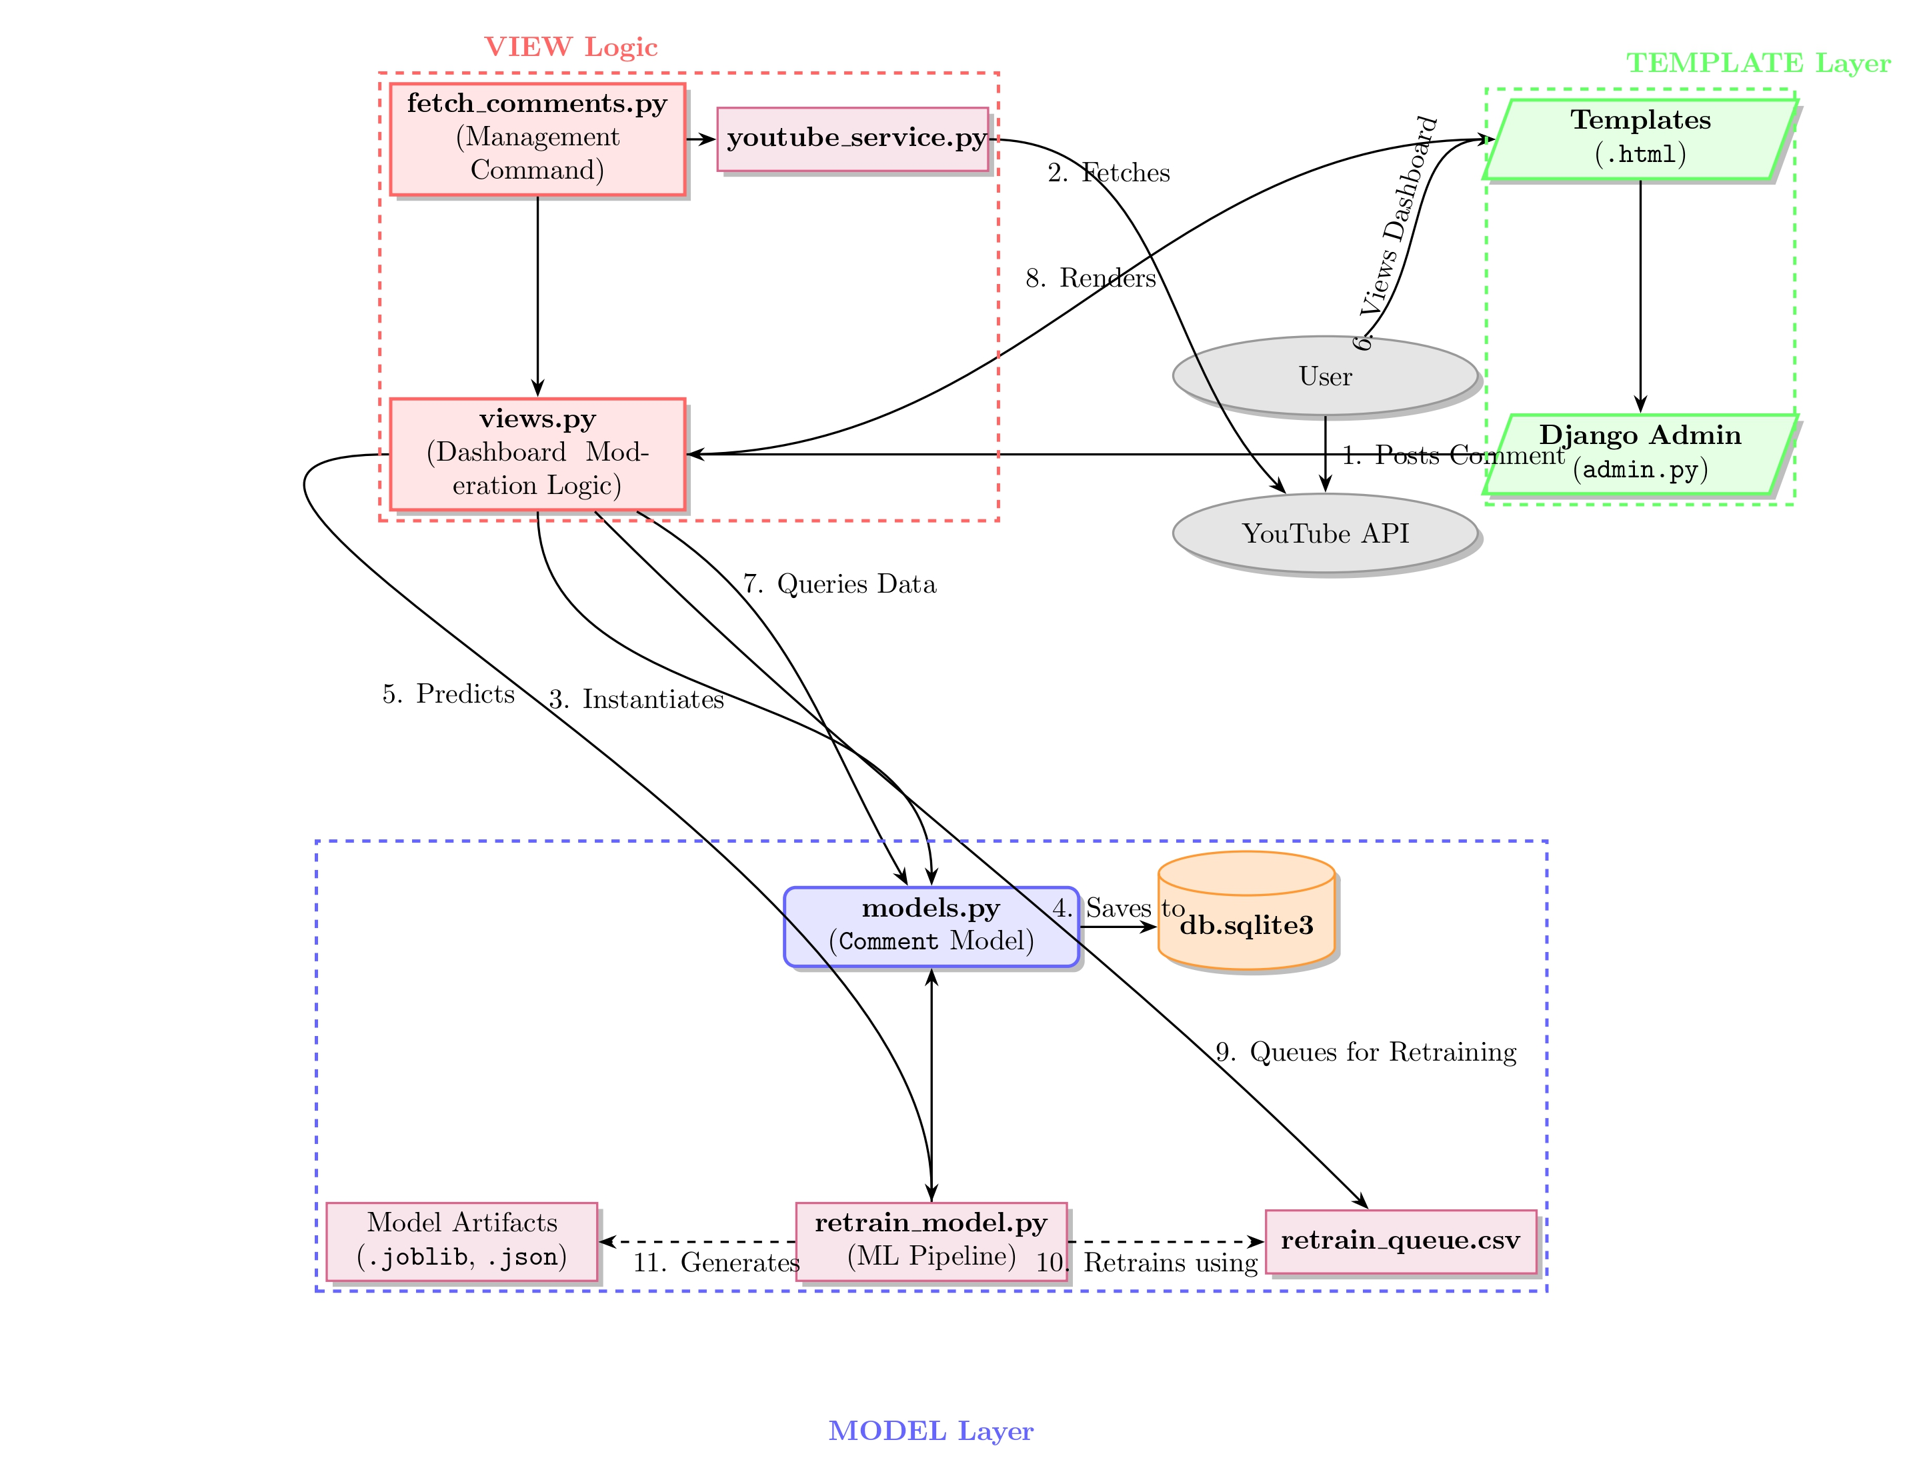
8. Proposed Method: Modules
Figure 2. Module Connectivity Diagram.

Slide 15
Module -1: Data Ingestion & Storage 📥
How comments enter and are stored in the system.
1. User Action: The process starts when a user posts a comment on a YouTube video.
2. Automated Fetching:
A custom Django command (fetch_comments.py) runs on a schedule or is triggered manually.
This command uses a service (youtube_service.py) to connect to the YouTube API and pull the latest comments.
3. Saving to Database:
Each fetched comment is structured using the Comment model (models.py).
The comment data is then saved into the central SQLite database (db.sqlite3).

Slide 16
Module - 2: Automated Classification & Visualization 🤖
How comments are processed and displayed to the user.
4. ML Classification:
Immediately after a comment is saved, the ML pipeline (retrain_model.py) is used.
It employs a TF-IDF vectorizer and a Logistic Regression classifier to automatically predict the comment's toxicity and assign a moderation status.
5. Dashboard & Analytics:
The main UI (dashboard.html) displays all comments with their predicted status.
An analytics page (log_analytics.html) provides visualizations of comment trends and moderation activity using Chart.js.
6. Admin Interface:
The Django admin panel (admin.py) provides superusers with direct, raw access to view and manage comment data.

Slide 17
Module - 3: Manual Moderation & Feedback Loop 👨‍⚖️
The essential human-in-the-loop workflow for quality control.
7. Manual Actions:
From the dashboard, a moderator can perform actions such as deleting a comment or moving it to a neutral queue. These actions are handled by functions within views.py.
8. Reclassification for Retraining:
If the model's prediction was incorrect, a moderator can reclassify the comment.
This critical action updates the comment's status and adds the corrected data to a dedicated CSV file: retrain_queue.csv. This file serves as the learning dataset for the model.

Slide 18
Module - 4: Model Improvement & System Summary 📈
Closing the loop to create a smarter system over time.
9. Model Retraining:
Periodically, the retrain_model.py script is executed again.
It uses the new, human-verified data from retrain_queue.csv to retrain the classifier, improving its accuracy.
Updated model files (.joblib) and performance metrics are saved.
10. System Flow Summary:
YouTube → Fetch Script → Database → ML Classification → Dashboard → Manual Correction → Retraining Queue → Model Retraining

Slide 19
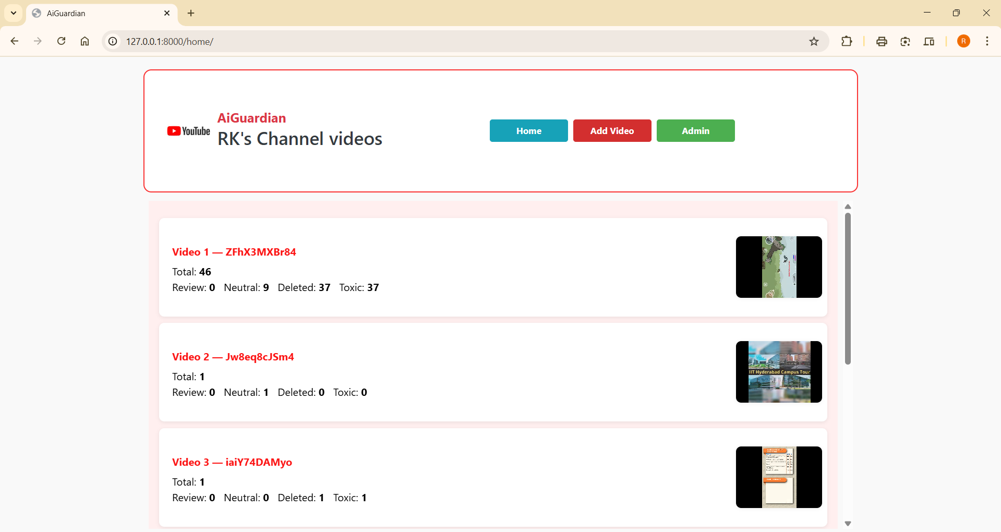
9. Proposed Method: Experimental Results
Fig 3: Home page

Slide 20
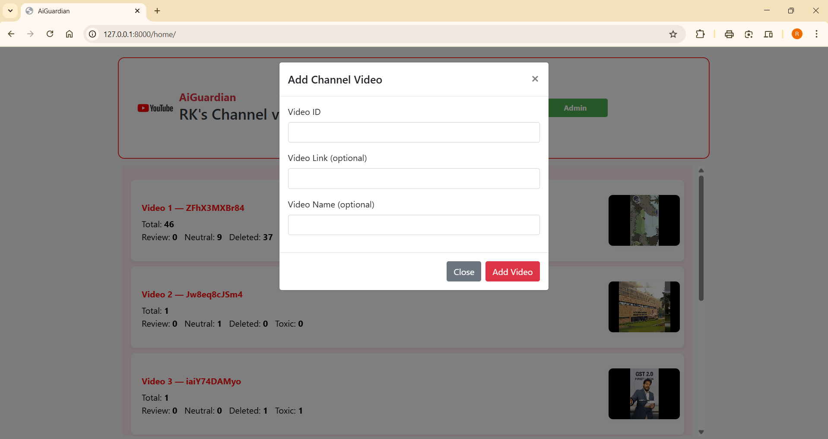
9. Proposed Method: Experimental Results
Fig 4: Add Video page

Slide 21
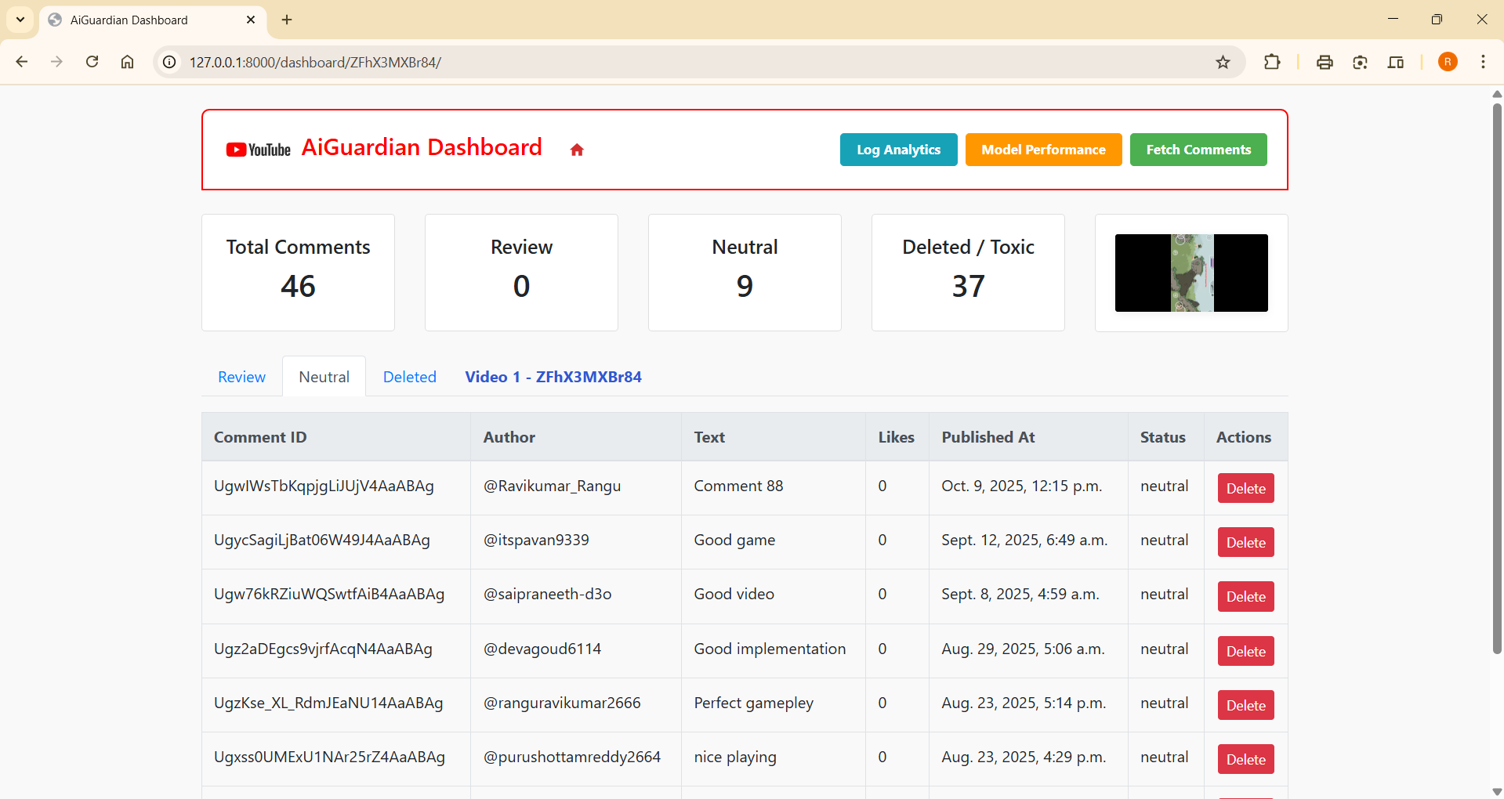
9. Proposed Method: Experimental Results
Fig 5: Neutral Dashboard

Slide 22
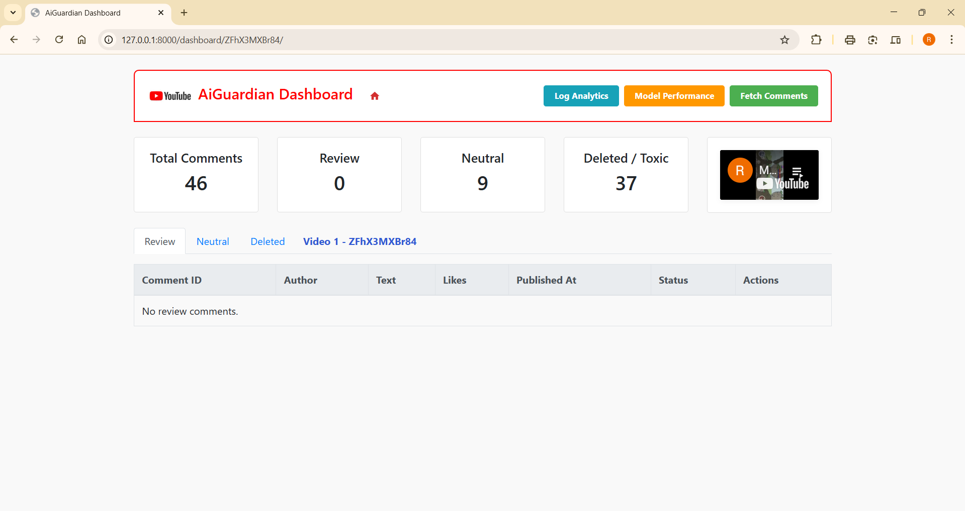
9. Proposed Method: Experimental Results
Fig 6: Review Dashboard

Slide 23
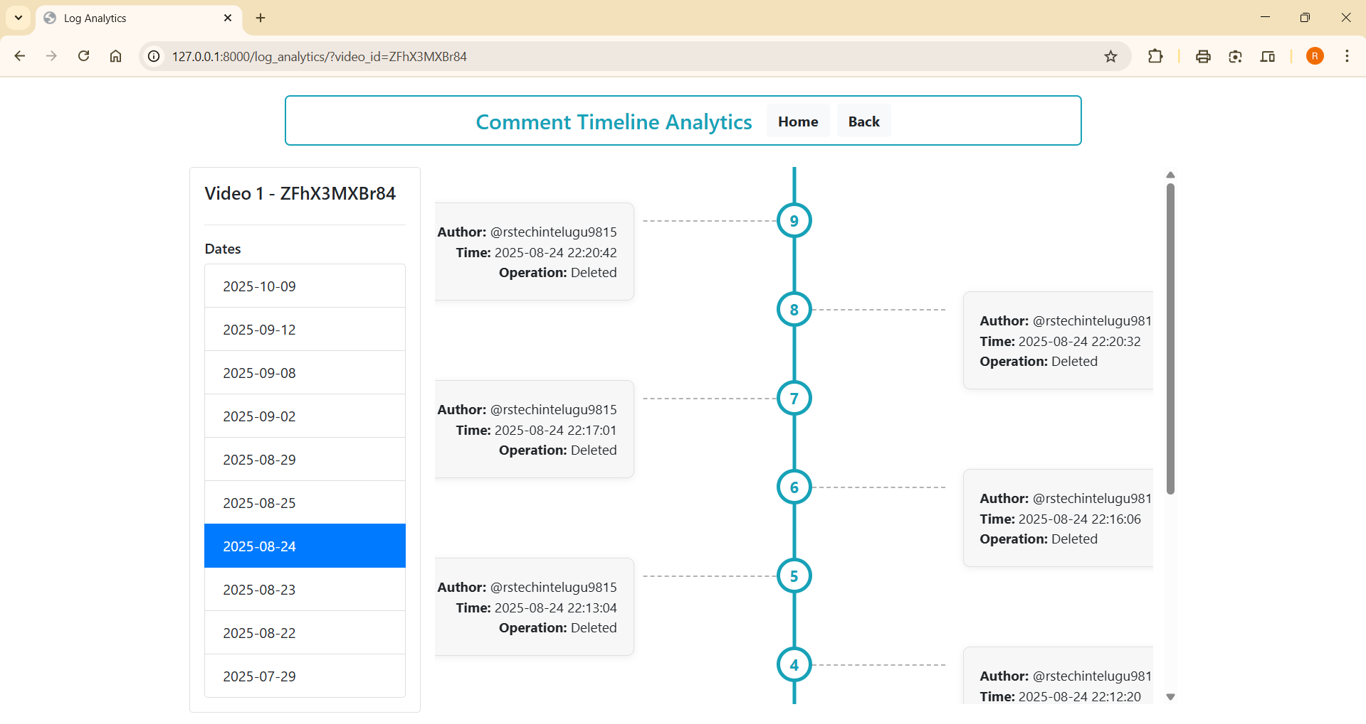
9. Proposed Method: Experimental Results
Fig 7: Timeline Analytics

Slide 24
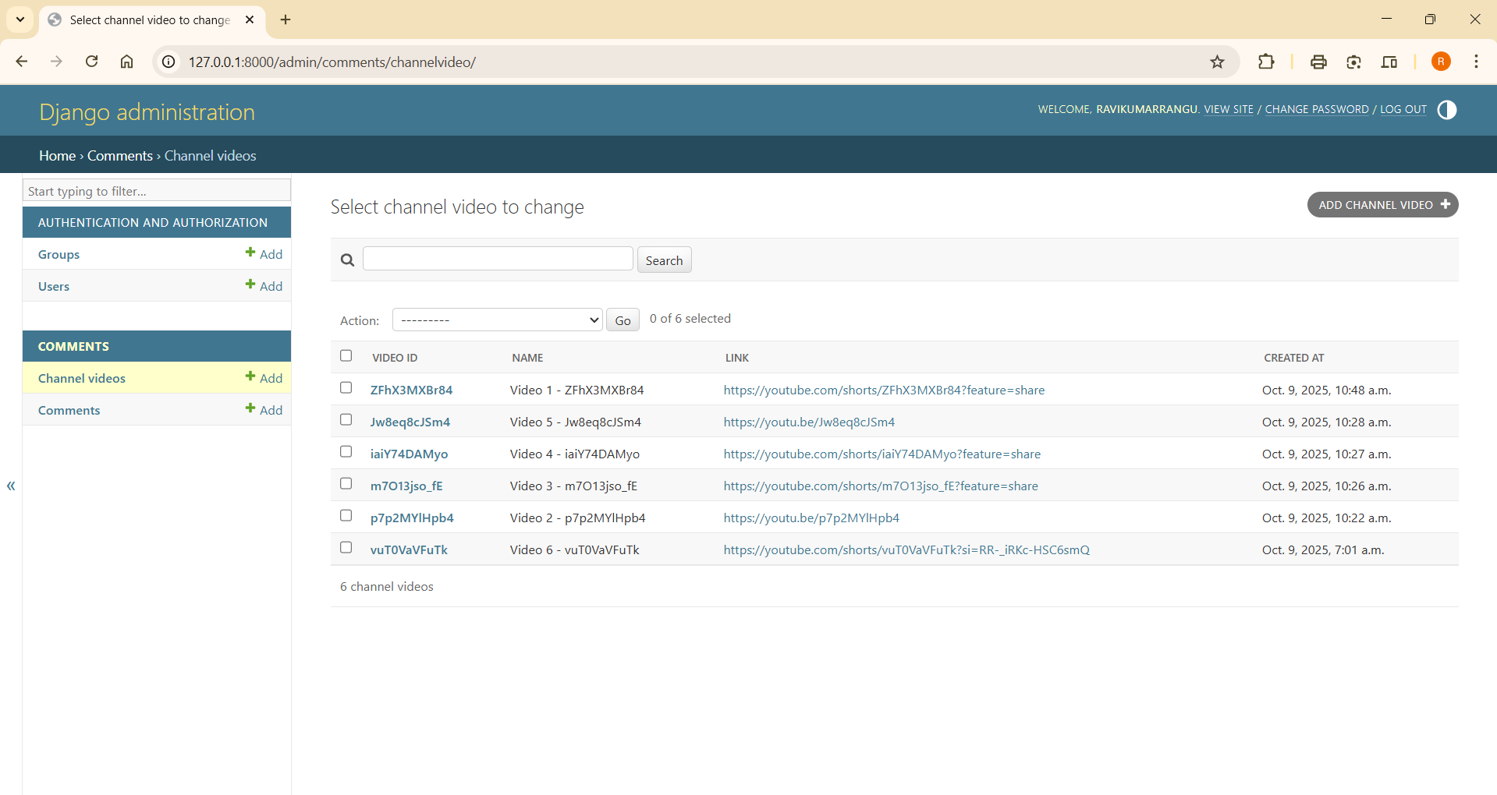
9. Proposed Method: Experimental Results
Fig 8: DBA Dashboard

Slide 25
10. Test Cases for the Project
S. No | Comment / Input | Predicted/ Output | Confidence | Top 3 Probabilities | Status | Output drive link
1 | 'This is a great video!' | Neutral | 0.414 | - Neutral: 0.414 - Obscene: 0.156 - Insult: 0.124 | Pass | click
2 | 'You are stupid idiot' | Toxic | 0.562 | - Insult: 0.562 - Neutral: 0.144 - Obscene: 0.093 | Pass | click
3 | 'go to hell bastard' | Toxic | 0.407 | - Harassment: 0.407 - Other: 0.328 - Insult: 0.126 | Pass | click

Slide 26
11. References
SecureComment: Safeguarding Online Discussions with Intelligent Toxic Comment FilteringR. K. Rayani et al., IATMSI 2024 (IEEE). doi: https://doi.org/10.1109/IATMSI60426.2024.10503420.
Toxic Comment Analyzer using BERT: A Deep Learning Approach for Toxicity DetectionR. Singh, R. Kashyap, V. Sharma, ICI 2023. doi: https://doi.org/10.1109/ICI60088.2023.10421672
Toxic Comment Classification Using S-BERT and Random ForestA. A. Kumar et al., IC3/InC4 2023 (IEEE). doi: https://doi.org/10.1109/InC457730.2023.10263218
Multilingual Abusive Comment Detection at Scale for Indic Languages (MACD)V. Gupta et al., NeurIPS Datasets & Benchmarks Track, 2022. doi:https://proceedings.neurips.cc/paper_files/paper/2022/file/a7c4163b33286261b24c72fd3d1707c9-Paper-Datasets_and_Benchmarks.pdf
Overview of HASOC Subtracks at FIRE 2023: SERP Sarah Masud et al., FIRE 2023. doi: https://ceur-ws.org/Vol-3681/T6-2.pdf

Slide 27
Overview of the HASOC Subtracks at FIRE 2023FIRE 2023 via ACM DL. doi: https://dl.acm.org/doi/10.1145/3632754.3633277
Annihilate Hates (Task 4 HASOC 2023): Hate Speech in Assamese, Bengali, BodoK. Ghosh et al., FIRE 2023. doi: https://digitalcommons.isical.ac.in/conf-articles/541/
Hate Speech & Offensive Content Detection in Indo-Aryan LanguagesN. Narayan et al., arXiv, Dec 2023. doi: https://arxiv.org/abs/2312.05671
DravidianLangTech 2025 Overview: Towards Safer Social MediaACL DravidianLangTech Workshop, 2025. doi: https://aclanthology.org/2025.dravidianlangtech-1.62.pdf
Overview of Abusive Comment Detection in TamilACL DravidianLangTech, 2022. doi: https://aclanthology.org/2022.dravidianlangtech-1.44.pdf

